Slide 1
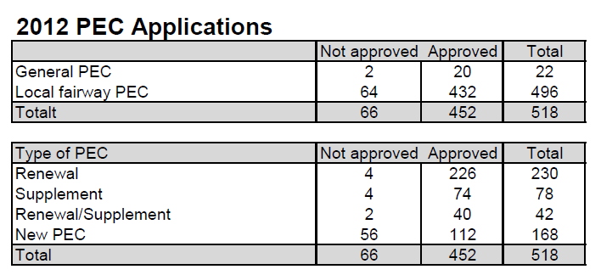
Pilot Exemption Certificate
1
Notes:
1

Slide 2
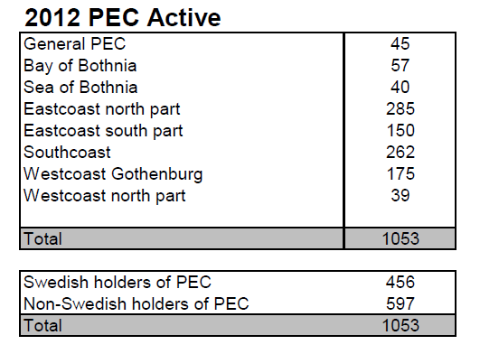
Pilot Exemption Certificate
2
Notes:
2

