Slide 1
BPAC 2013 - HELSINKI
Capt. Kazimierz Goworowski
UMS Marbalco Co. Ltd.

Slide 2
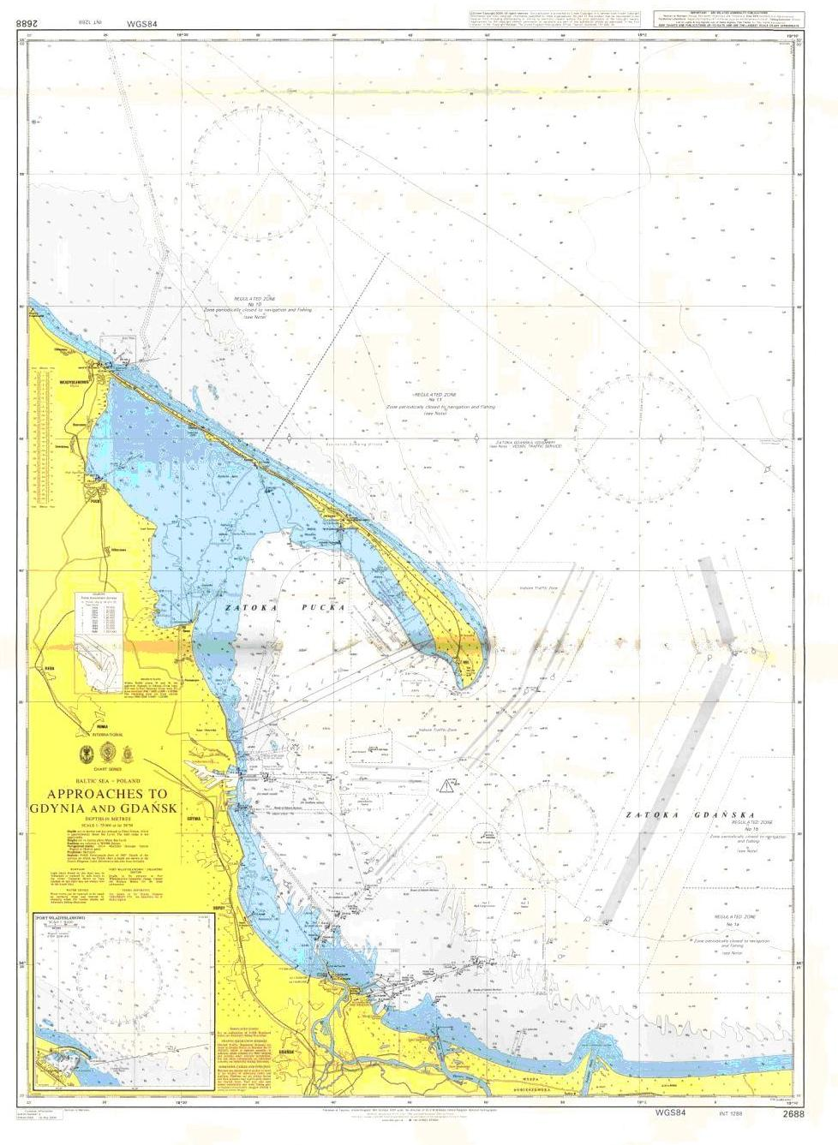
Approaches to Gdynia and Gdańsk

Slide 3
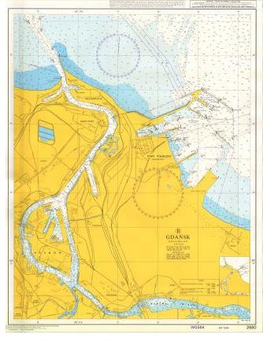
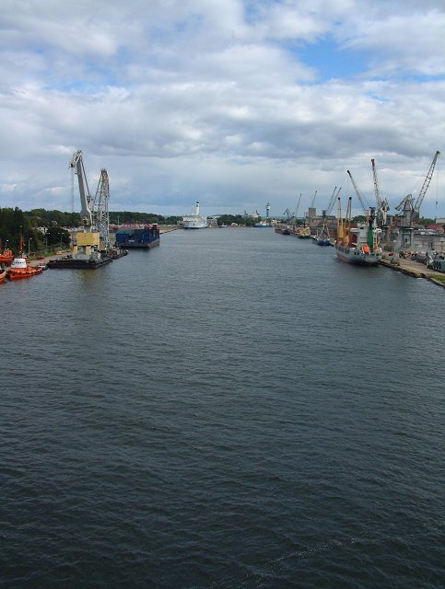
Port of Gdańsk
Gdańsk Inner Port Gdańsk „North Port”
Max vessel's length: 225 m Max vessel's length:
Max draught: 10,2 m containers – 400 m, tankers – 350 m
Max draught:
containers – 14,2 m, tankers - 15,0 m

Slide 4
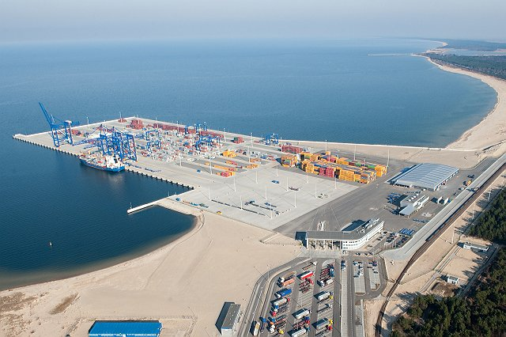
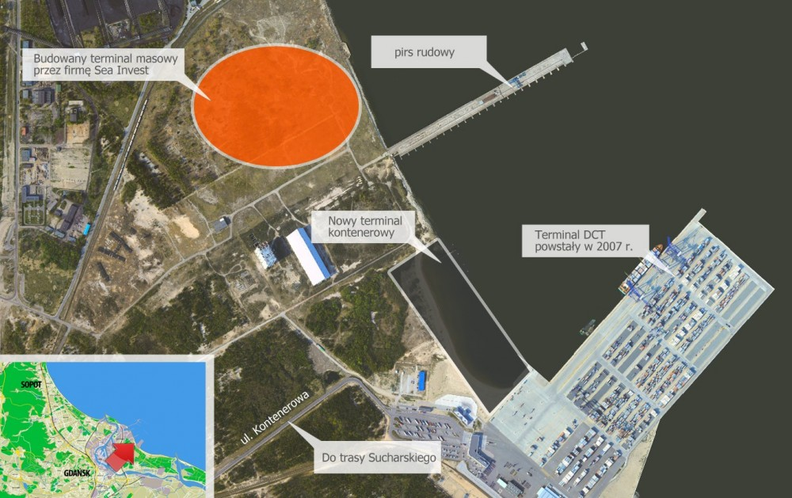
Deepwater Container Terminal at Gdańsk North Port – Baltic Hub.
This year building of new terminal DCT 2 will be commenced.
Expected to be ready at end of 2015.
At the end of August 2013 expecting arrival of the biggest
Tripple-E Container Vessel – m/v MAERSK McKINNEY MOLLER,
LOA: 400 m ; GT: 174,500; TEU: 18,000.
So far the biggest vessel which arrived to DCT was EMMA type:
LOA: 398 m; GT: 170,794 TEU: 15,550
Berth length:
Max draught:
Cont. Handling rate:
650 m
14,2 m
30 moves/hr.

Slide 5
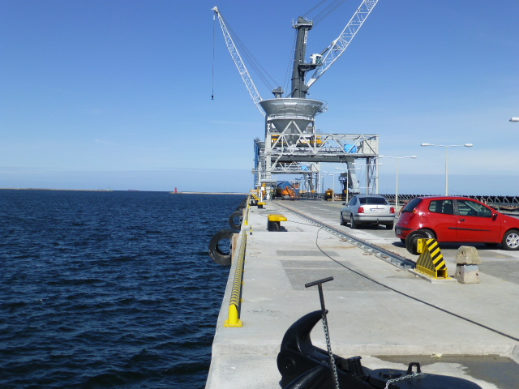
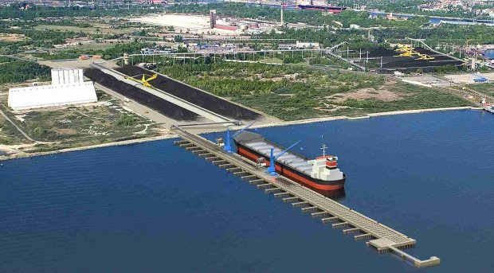
North Port Gdańsk
New Bulk Terminal
New bulk terminal is almost completed in the Gdańsk North Port.
Deep water berth will accept vessels up to 15,5 m draft.
Completion and first vessel call expected in Autumn 2013.

Slide 6
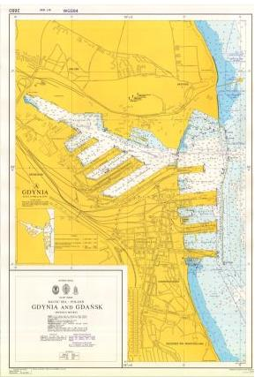
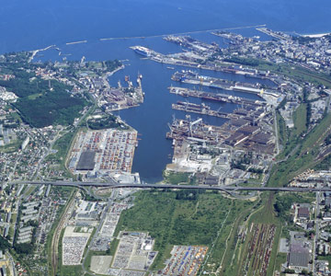
Port of Gdynia
Max vessel's length:
Max draught:
300 m
13,0 m

Slide 7
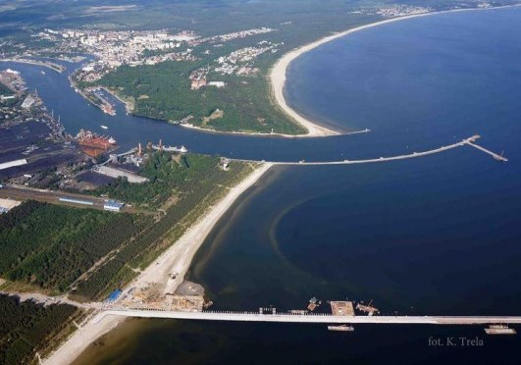
Approaches to Świnoujście and Szczecin

Slide 8
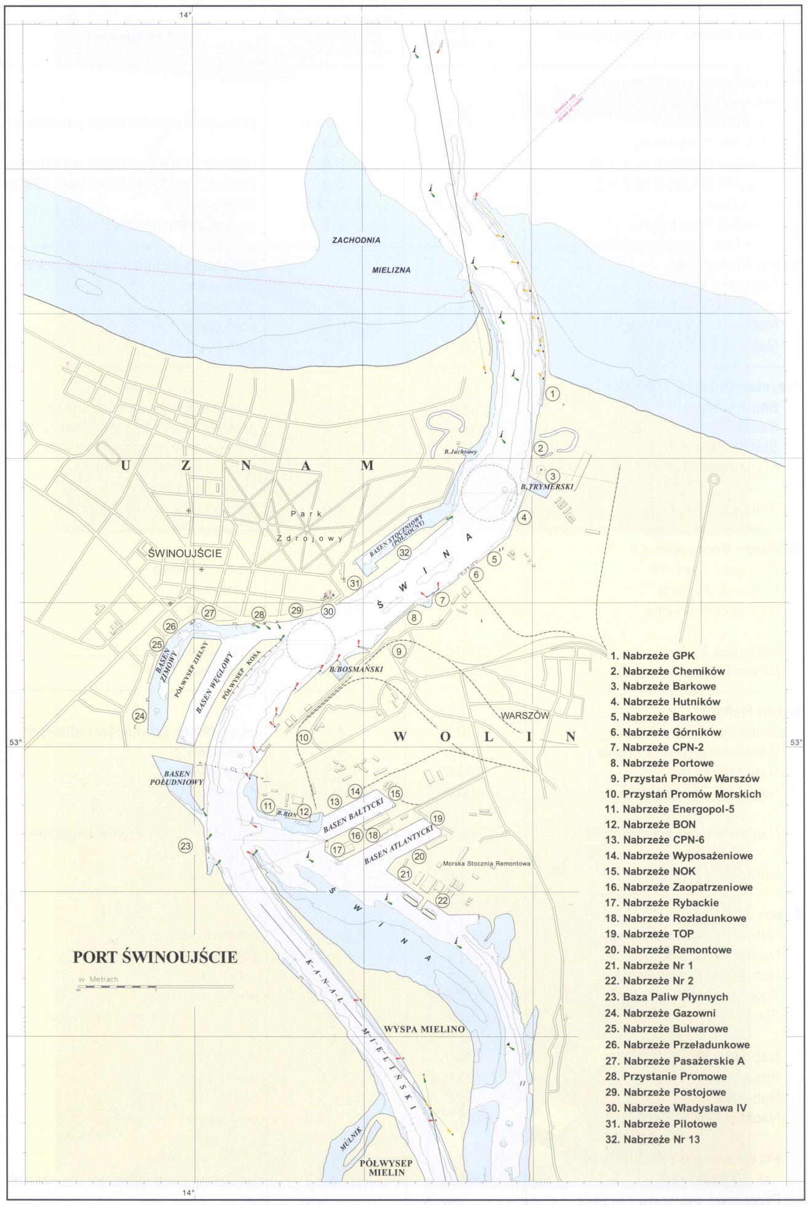
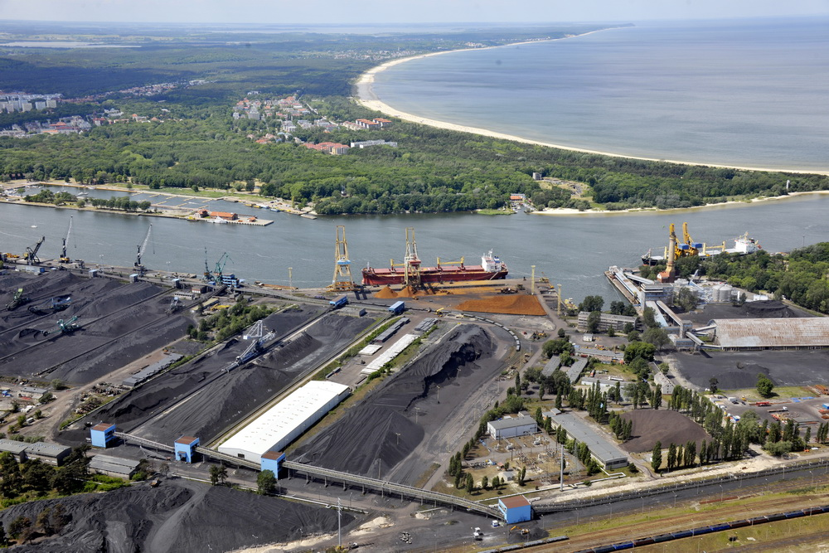
Port of Świnoujście
Max vessel's length:
Max draught:
270 m
13,2 m

Slide 9
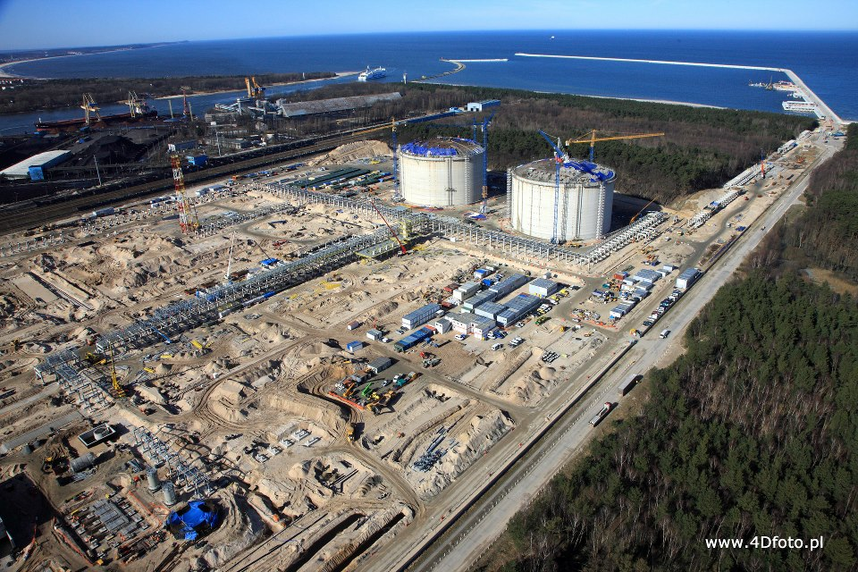
New LNG Terminal under construction at Świnoujście
Max vessel's length:
Max draught:
Fairway depth:
On 17 May 2013 the main breakwater has been completed.
Works have advanced lately and the Terminal should be operational in middle of 2014.
315 m
12,5 m
14,5 m

Slide 10
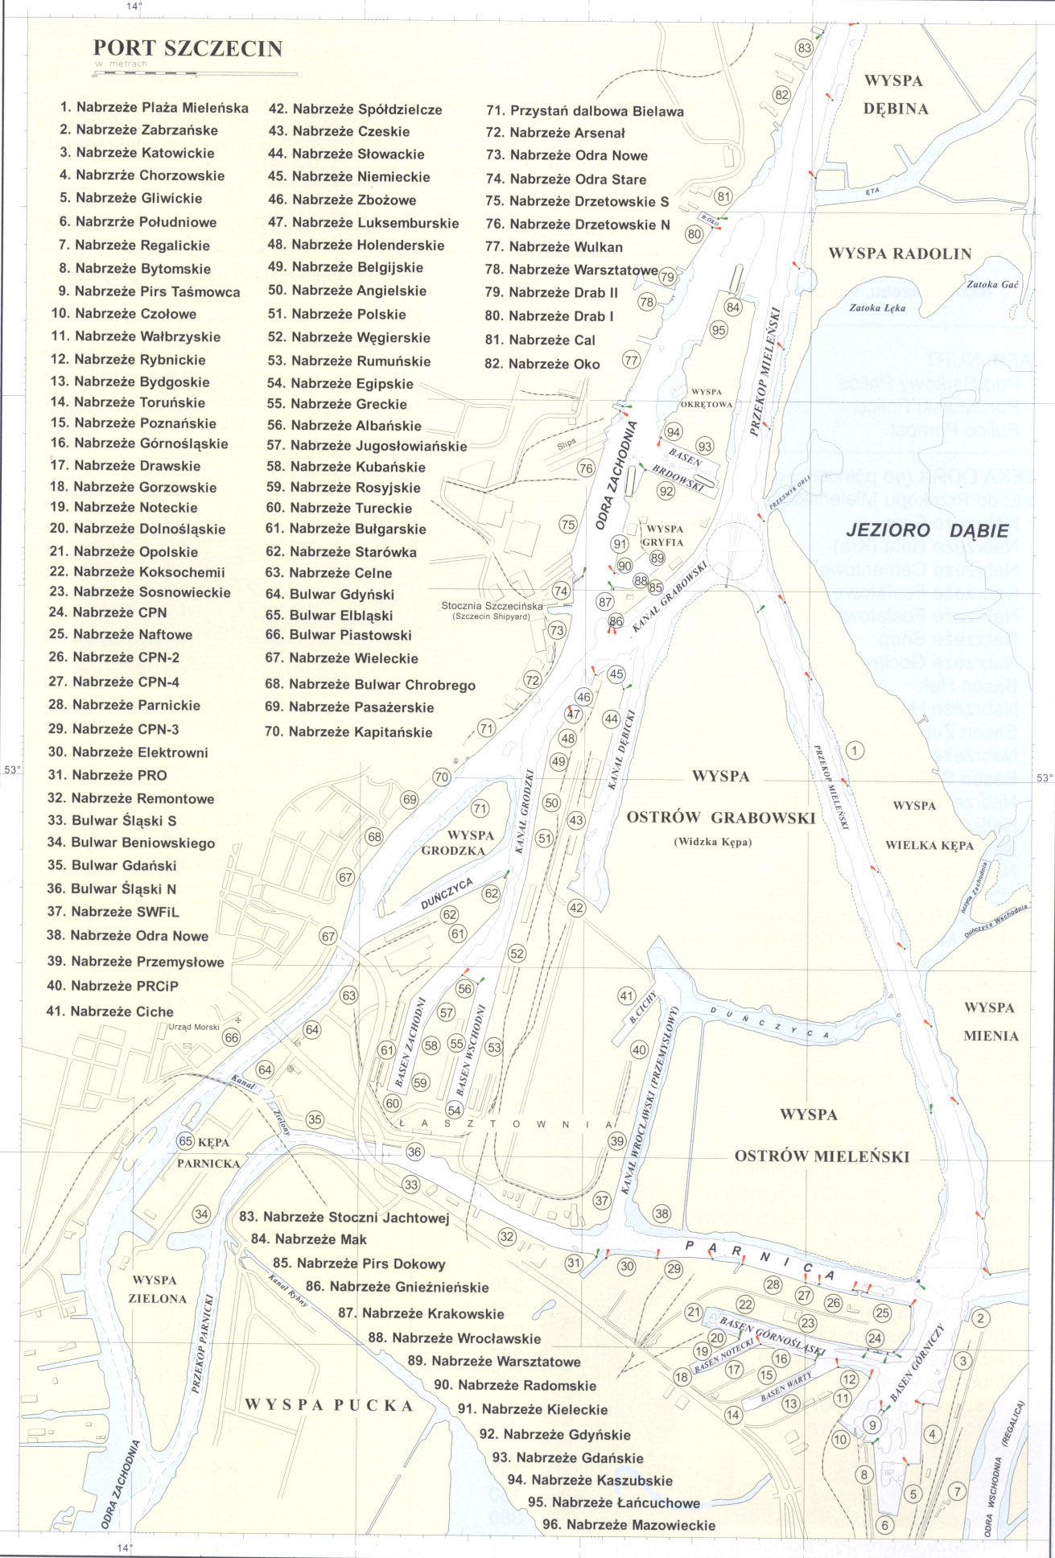
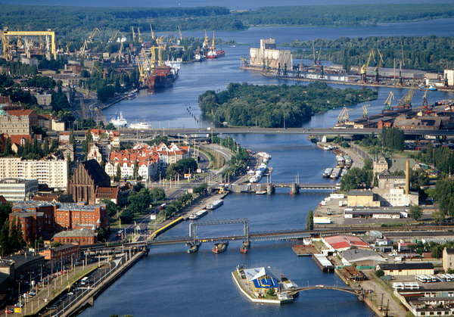
Port of Szczecin
Max vessel's length:
Max draught:
215 m
9,15 m

Slide 11
Statistics of vessels Arrivals and departures to Polish Ports in Year 2012 comparing to 2011

Slide 12
Statistics in All Pilots Stations in Year 2012 comparing to 2011

Slide 13
„ PILOT EXEMPTION CERTIFICATES „ Issued in Year 2012

Slide 14
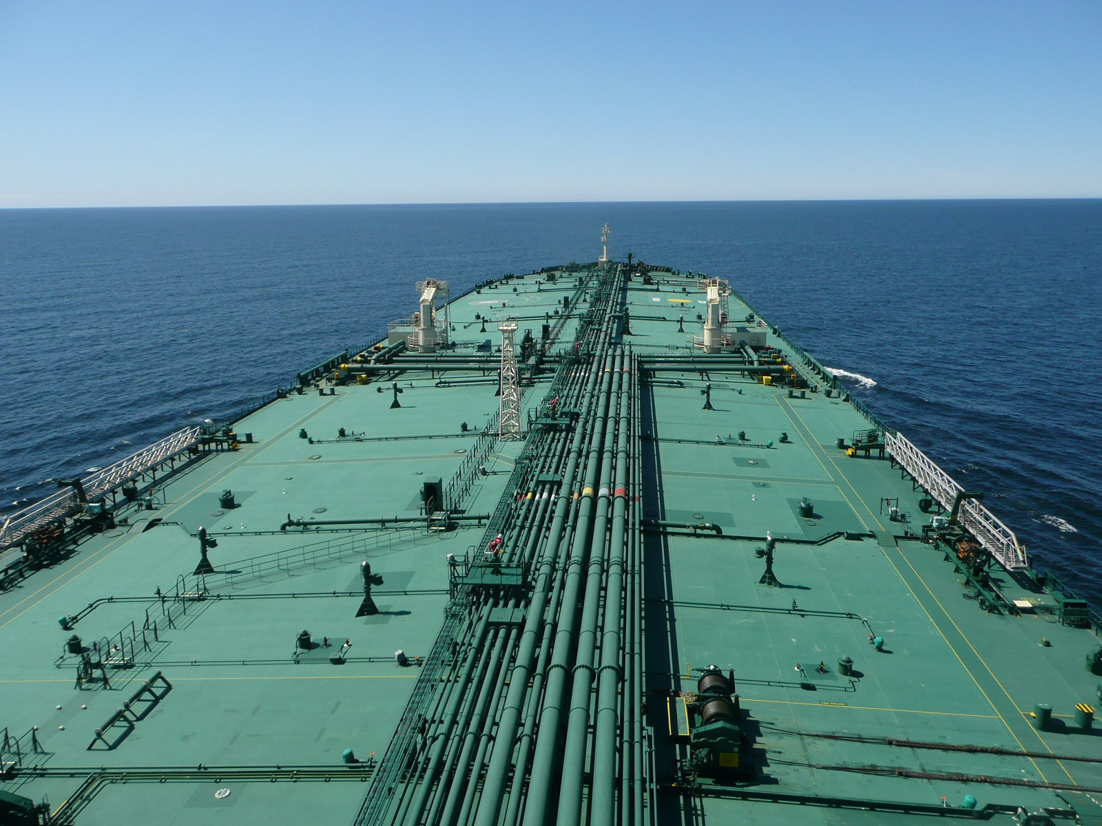
POLISH DEEP SEA PILOTS IN SERVICE
Pilot Licence No.
Capt. Kazimierz Goworowski GUM-201-077231-3648/2012
Capt. Włodzimierz Juszkiewicz GUM-201-000928-5944/2012
Capt. Mirosław Drozd GUM-201-004002-4323/2011
Capt. Feliks Kopij GUM-201-019360-2933/2011
Capt. Marek Bielecki GUM-201-008529-3259/2010
Capt. Waldemar Frankiewicz GUM-201-073652-2189/2011
New pilots
On 1 April 2009 2 captains passed deep sea pilot's exam
at Gdynia Maritime Authority :
Capt. Jarosław Grzech
Capt. Grzegorz Puzio

Slide 15
Thank you for your attention.
See you next year.

