Slide 1
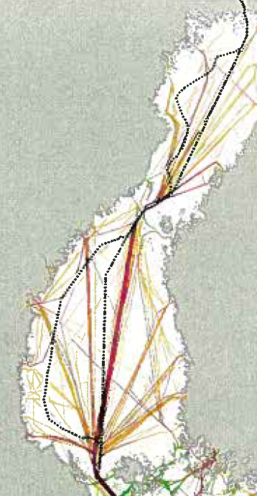
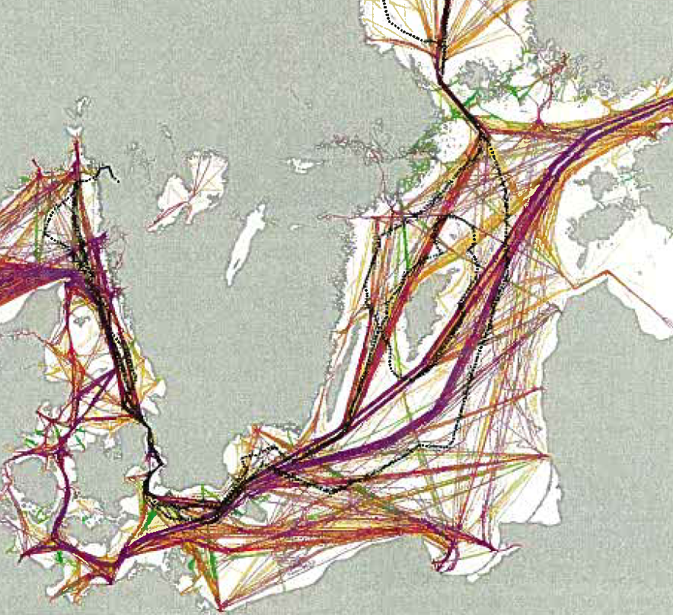

Slide 2
2011-01-28
2

Slide 4
2011-01-28
4

Slide 6
