Slide 1
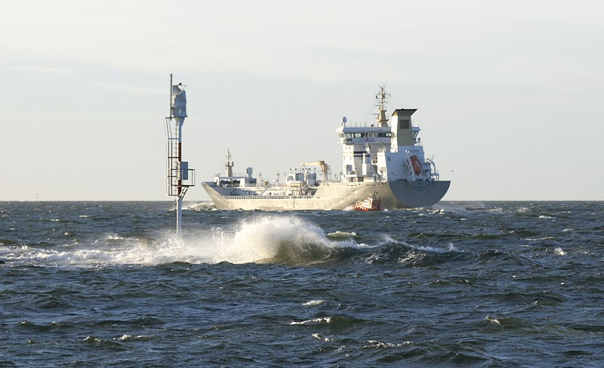
Plans and development within the CPA in Finland
BPAC 2.2.2011
Valtteri Laine

Slide 2
Pilotage in Finland
New Pilotage Act 1.1.2011
Finnpilot is replaced with Finnpilot Pilotage Ltd
English is allowed as a PEC language since July 2011
Exemptions limited to 3 700 GT except icebreakers
New Government Decree on Pilotage
The amounts of training voyages will be increased
The use of ship simulators will be increased
The role of nautical institutes will be more important

Slide 3
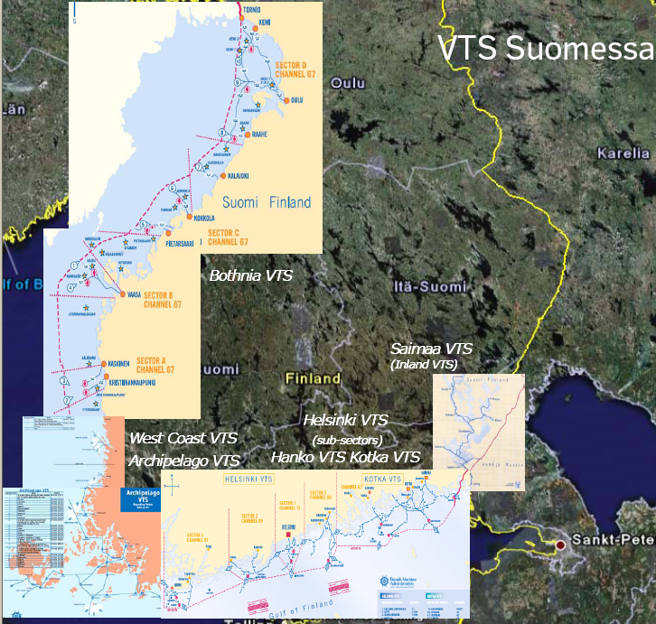
English as a PEC language
English will be accepted as a PEC
language only in certain parts of
Finland.

Slide 4
MINTC Workgroup Openeing of the pilotage services to markets

Slide 5
Pilotage in Finland

Slide 6
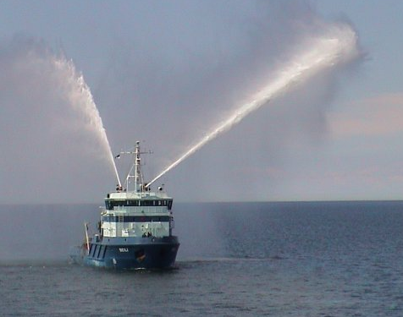
Thank you for your attention!

