Slide 1
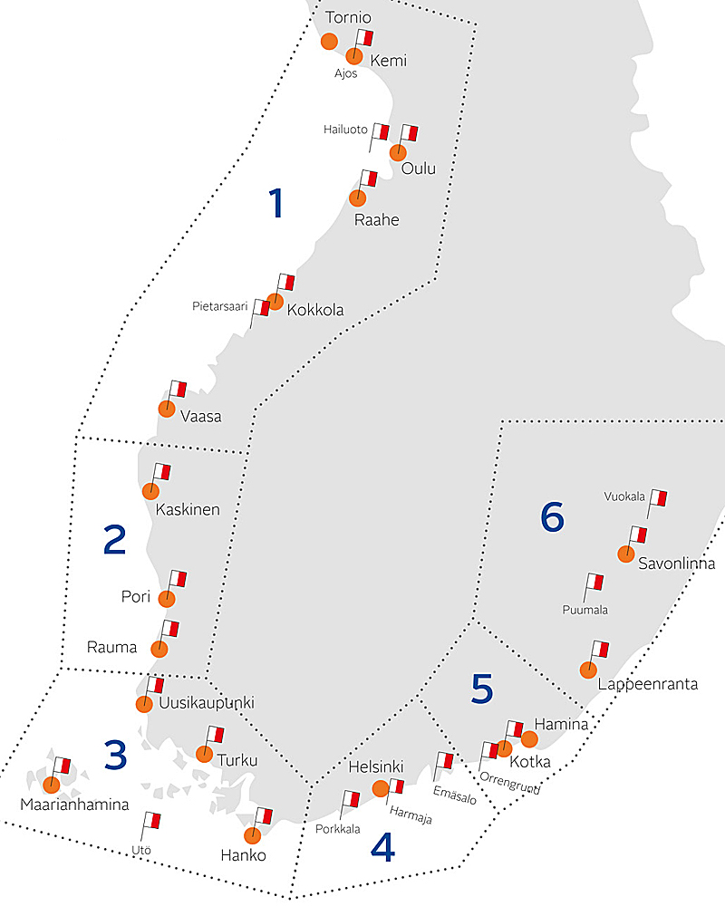
Areas, stations and personnel
Pilotage operations have been divided into six pilotage areas.
  1 Bay of Bothnia
  2 Bothnia Sea
  3 Sea of Archipelago
  4 Helsinki
  5 Kotka
  6 Saimaa
- Finnpilot has a total of 24 pilot and support stations.
- 150 pilots, 130 cutter drivers, 18 pilot order centre, 18 administration

Slide 2
Finnpilot in figures
Basic numbers 31.12.2012 31.12.2011
Pilotages 27 091 30 075
Pilotages, nautical miles 509 700 579 784
Turnover, M€ 39,4 36,0
Profit +3,8 M€ + 0,9 M€
Equity ratio % 46,8 % 44,2 %

Slide 3
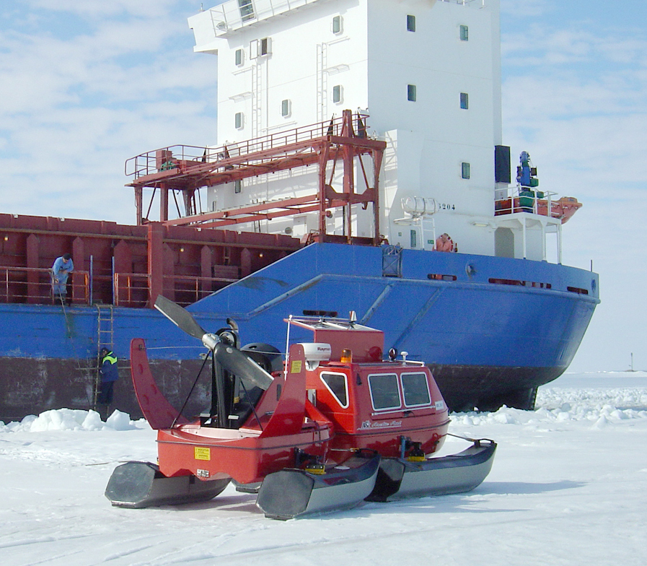
Pilotage equipment
30 fast pilot boats
    weight 7.5-15 tonnes
    speed 20-29 knots
  33 pilot cutters
    weight 45-60 tonnes
    Speed ca 10 knots
  9 hydrocopters

Slide 4
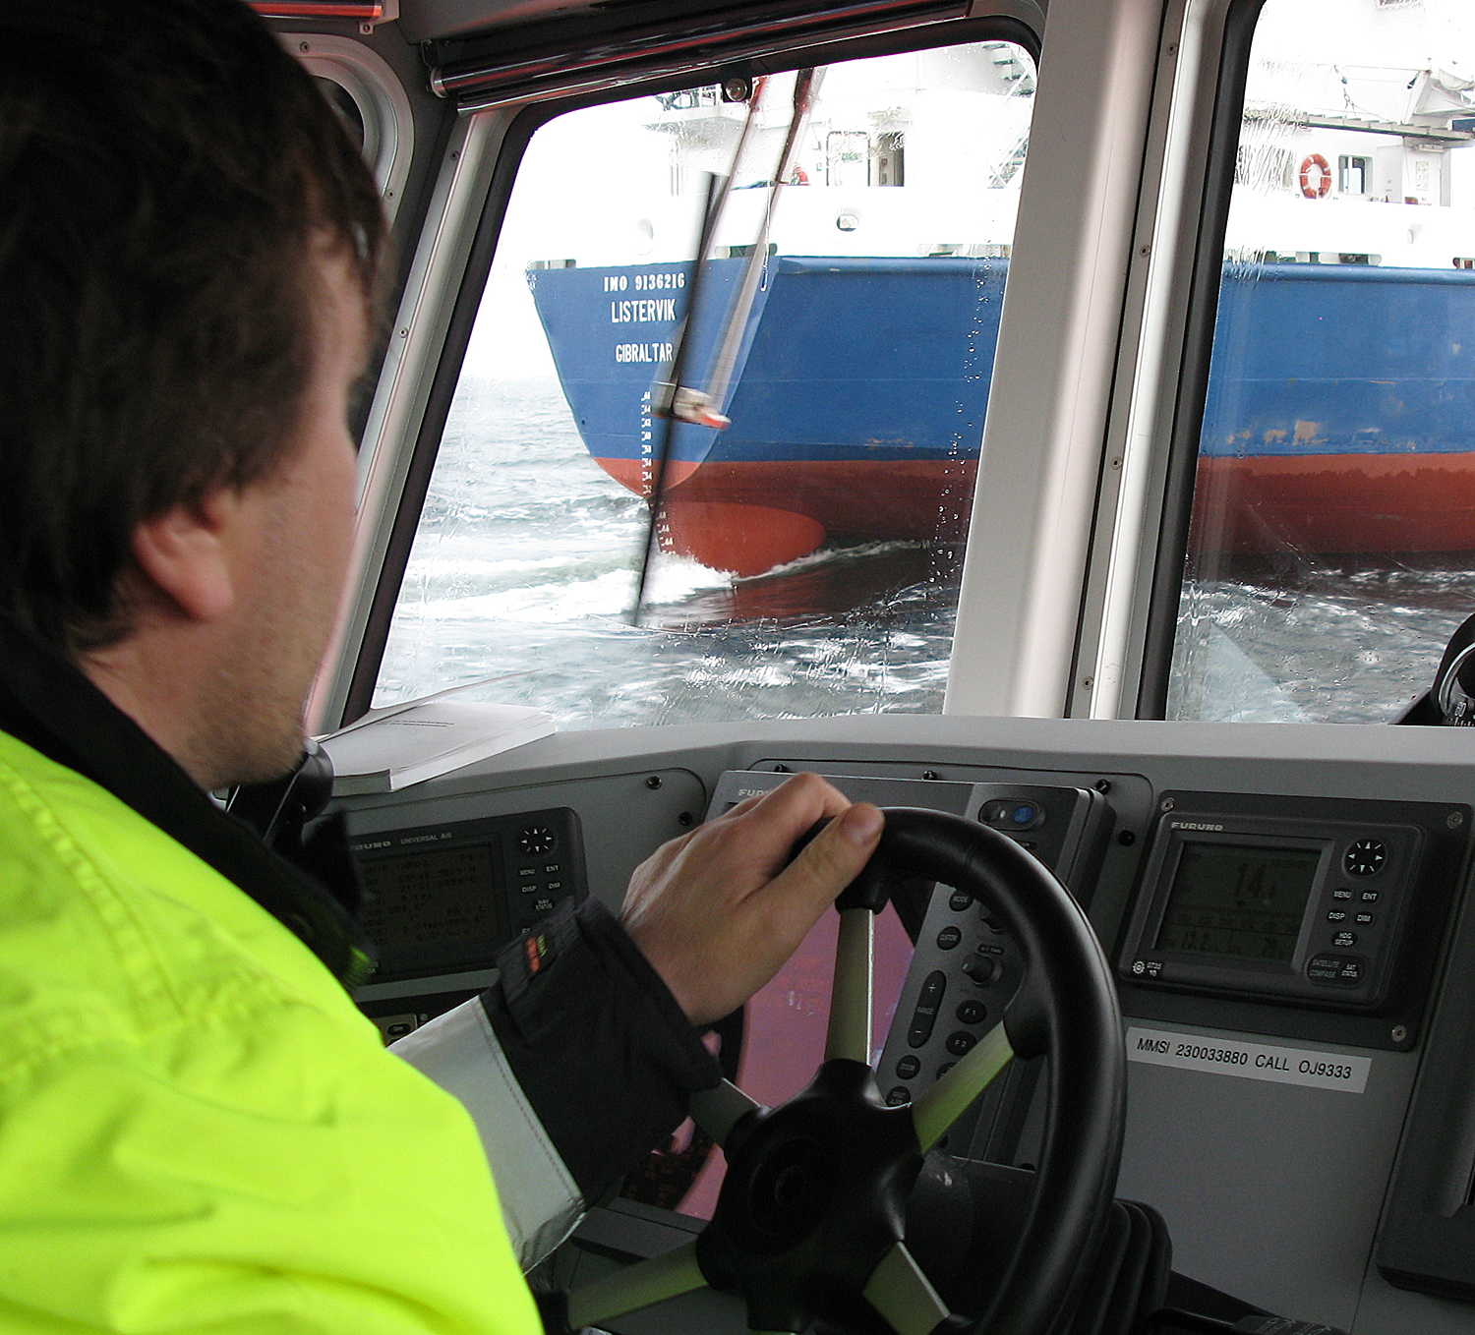
Quality, effectiveness and mobile pilotage process
Finnpilot received a quality certificate (DNV) in accordance with the ISO 9001 standard in December 2011.
Effectiveness of pilotage is a research project. Ultimate goal is to calculate what stakeholders are getting when they pay pilotage fees. First independent study (University of Turku) will be published in the autumn 2013.
All Finnish pilots will have iPad- mini during 2013. With that equipment it is possible to manage pilotage process more precisely (rest times, next vessels, working time, etc.). There is also information about other traffic, weather, full list of pilotages and no more paper sales slips -> master signs receipt on iPads screen.

